Slide 1


Data Analytics Using Tableau Advanced
(A Step Towards Data Science)

Slide 2
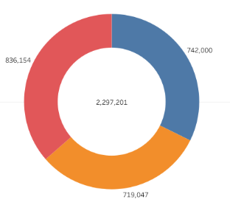
Donut Chart
Donut charts offer a quick, high-level view of data dimensions that have a few members, and together, they contribute to a whole. Essentially, it is a pie chart with a hole.

Slide 3
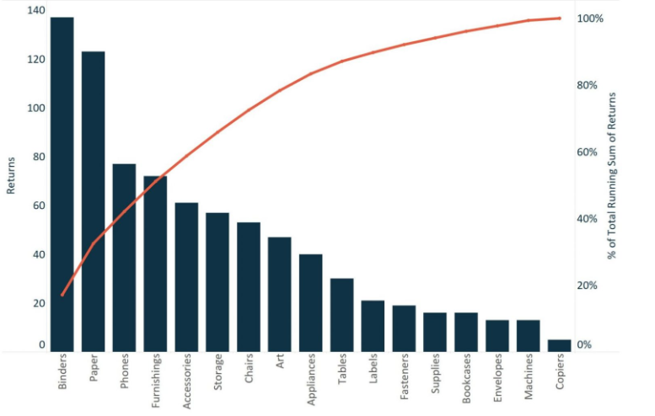
Pareto Chart
A Pareto Chart, named after Vilfredo Pareto, is a dual-axis combination chart used to highlight dimension members that have the biggest impact on the measure in question. On the primary axis, bars are used to show the raw quantities for each dimension member, sorted in descending order.

Slide 4
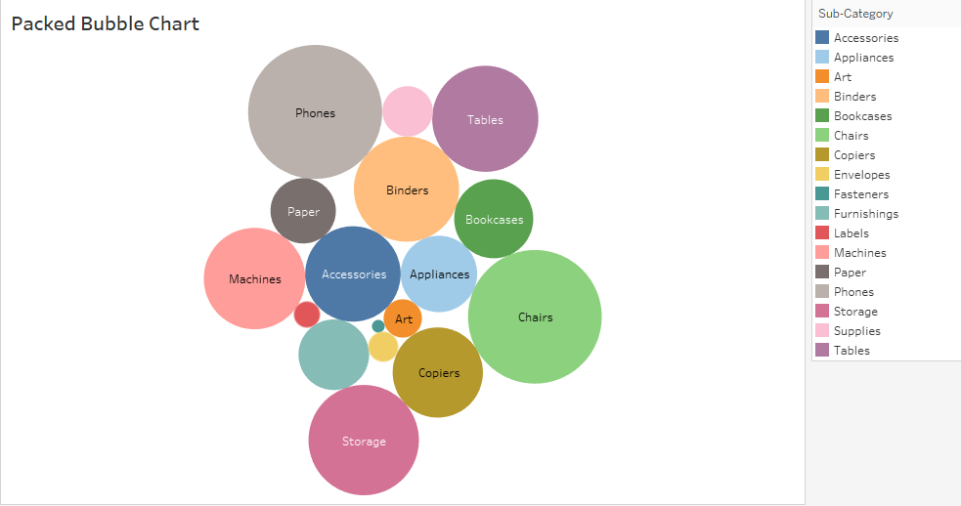
Packed Bubble Chart
Packed bubble charts are visualisations wherein the size and, optionally, the colour of the bubbles are used to visualise the data.

Slide 5
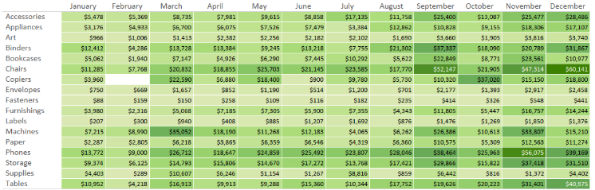
Highlight Table Chart
Highlight tables are used to compare categorical data using colour.

Slide 6
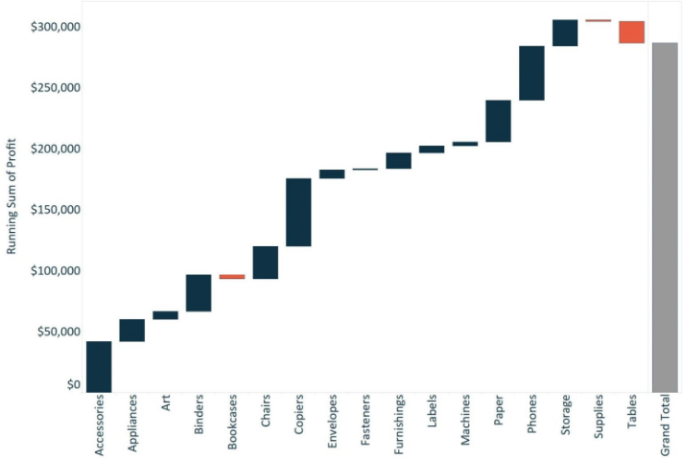
Waterfall Chart
A waterfall chart effectively displays the cumulative effect of sequential positive and negative values. It shows where a value starts, ends and how it gets there incrementally.

Slide 7
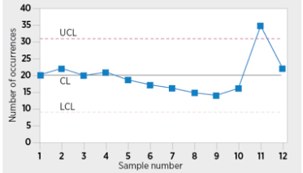
Control Chart
The control chart is a graph used to study how a process changes over time. Data are plotted in time order. A control chart always has a central line for the average, an upper line for the upper control limit, and a lower line for the lower control limit.

Slide 8
LOD EXPRESSIONS
A level of detail expression is a syntax that simplifies and extends tableau’s calculation by making it possible to address detailed queries directly.
Types:
Include: calculating at lower level of detail
Fixed: Specifying the exact level of detail
Exclude: calculating at higher level of detail

Slide 9
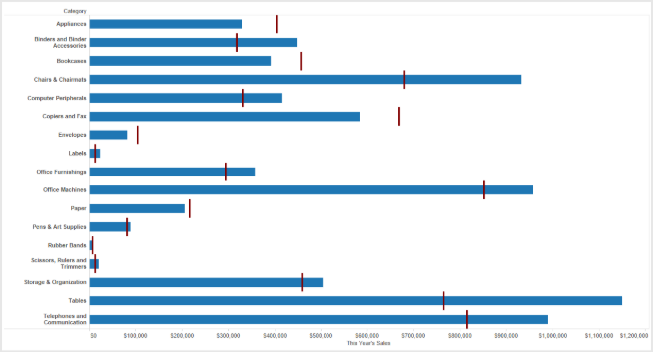
Bullet Chart
A bullet chart is a variation of a bar chart. In a bullet chart, we compare the value of one measure with another measure in the context of finding the variation in the first measure within a range of variations in the second measure.

Slide 10
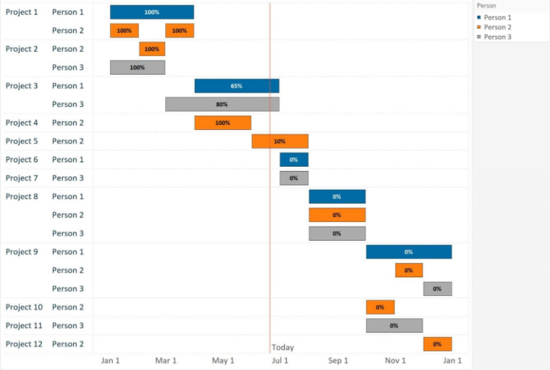
Gantt Chart
A Gantt chart shows the progress of the value of a task or resource over a period of time. It is extensively used in project management and other types of variation studies over a period of time.

Slide 11
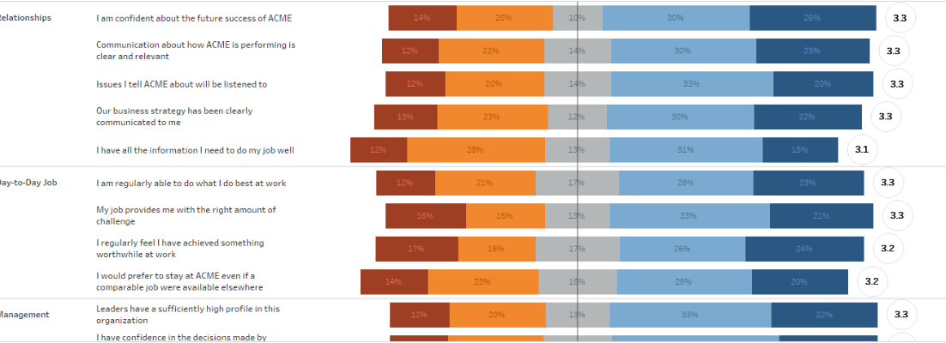
Likert Scale Chart
A Likert scale is a type of rating scale used to measure attitudes or opinions in research. On this scale, respondents are asked to rate items based on the level of agreement.

Slide 12
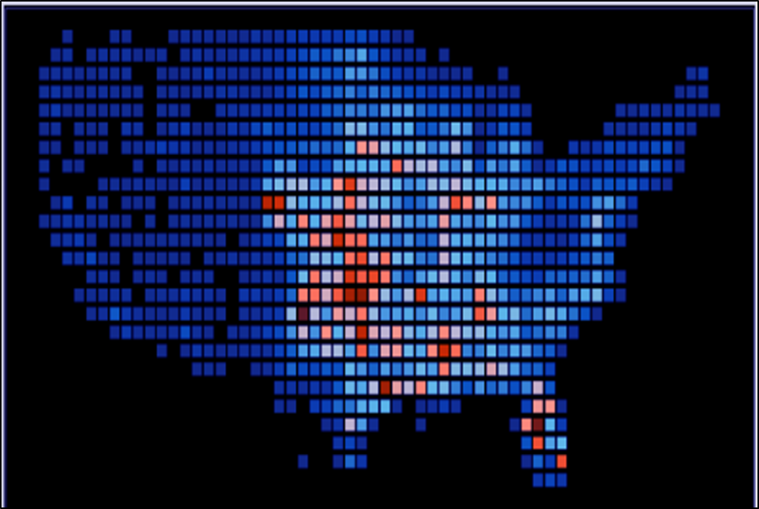
Hexbin Chart
A Hexbin plot is useful for representing the relationship between two numerical variables when you have a lot of data points. Instead of overlapping, the plotting window is split into several hexbins, and the number of points per hexbin is counted. The colour denotes this number of points.

Slide 13
BEST PRACTICES OF DATA VISUALISATION
Fulfil the purpose: Define the purpose of your visualisation and you can focus on achieving that objective
Consider your audience: Knowing who will use your visualisation for analysis is equally critical as knowing its purpose. You should consider your audience and their degree of familiarity with the subject and the underlying data, as well as their comfort level with charts and graphs.
Provide context: If your audience does not know the source of the data, the time of its collection or the way in which it relates to them, the visualisation will lack meaning and impact. Ensure that your visualisation contains the supporting information that provides answers to all the questions that your audience might have.
Show the numbers: One of the benefits of using spreadsheets for visualisation that a lot more information can be showed in less space without having to show every number; however, the numbers are important and should be shown for all the critical components of visualisation.
Present the most important information first: Ensure that you present the most critical information first. This applies to displaying the overall layout and to sorting data that is shown within each element of visualisation.
Pay attention to aesthetics: The overall aesthetics are also quite important for good visualisations. Make sure that the overall presentation of your visualisation is neat and crisp, with effective use of colour; aligned components; and consistent use of fonts, size and placement.

Slide 14

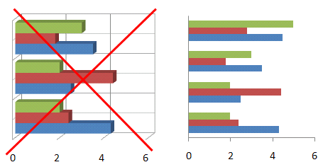
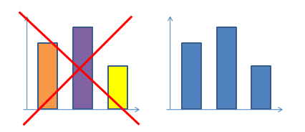
BEST PRACTICES OF DATA VISUALISATION
Reduce the non-data pixels, by eliminating them and de-emphasizing the remaining non-data pixels.
Eliminate unnecessary
Third dimension of depth on charts
Eliminate unnecessary
Grid lines in bar graphs
Eliminate variations in colour that
Don’t encode any meaning

Slide 15
BEST PRACTICES OF DATA VISUALISATION
Enhance data pixels by eliminating unnecessary data pixels and highlighting most important data pixels
Remove data that is less relevant
Condense data by summaries and exceptions
Emphasise important data by visual attributes like color intensity, size, line width
Emphasise important data by its position on the dashboard: top-left and center are sections with greatest emphasis
Neither Emphasised nor de-emphasised
Emphasised
Emphasised
Neither Emphasised nor de-emphasised
De-emphasised

Slide 16
